Slide 1


Paper No: 24PESGM0624
Data-driven Approximation of VPP Feasible Regions
Ruike Lyu (presenter), Hongye Guo, and Qixin Chen
EE., Tsinghua University
lvruike1999@163.com
https://www.researchgate.net/profile/Ruike_Lyu

Slide 2
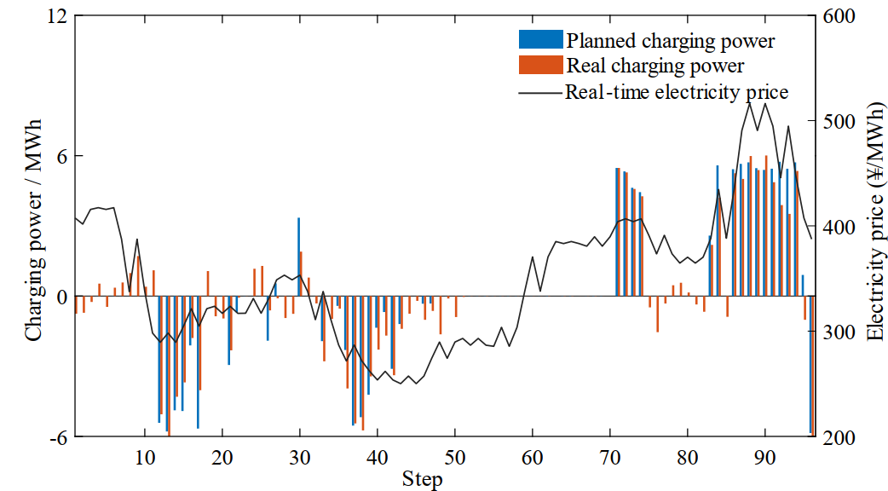
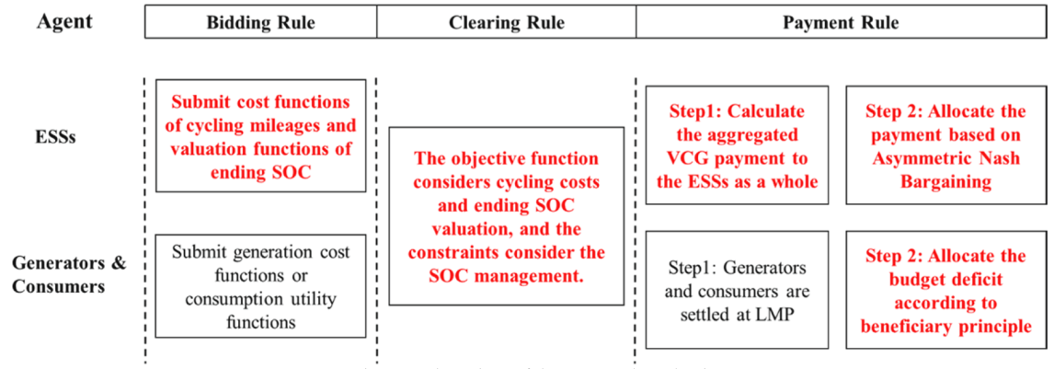
Background
ISOs are introducing new bidding models
to better integrate emerging distributed energy resources (DERs)
new bidding models to represent DER feasible regions (FRs)
incorporating FR into dispatch model, instead of self-dispatch
Difference between self-dispatch and optimal dispatch results #
New bidding models designed for energy storages*
*Fang et al., 2022.
#Wei et al., 2022
2

Slide 3
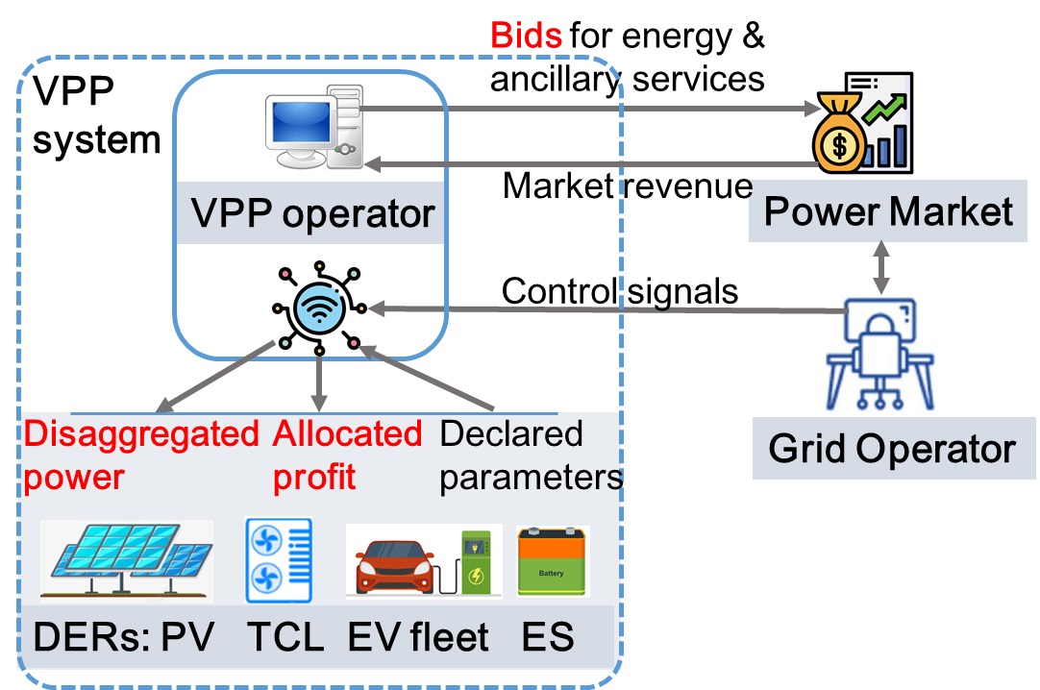
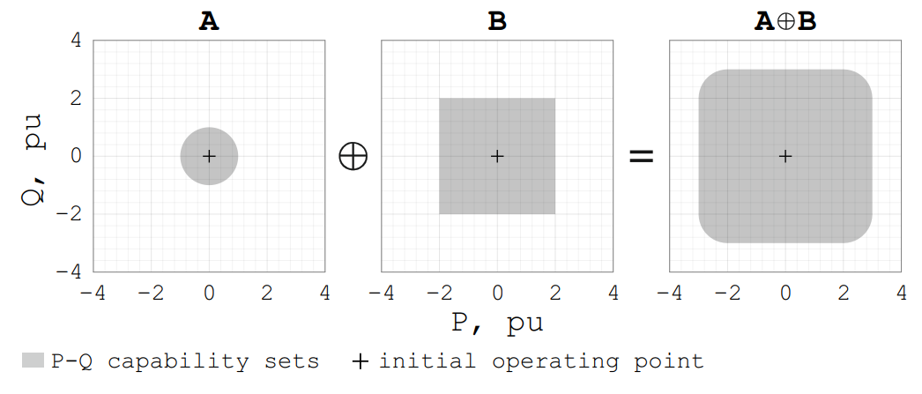
Background
Bidding of VPP: feasible region aggregation
small-capacity DERs needs aggregation by Virtual Power Plants (VPPs)
VPP submits its FR as a whole through the bidding model
addition of multiple sets (Minkowski addition): NP-hard
Example: Minkowski addition of P-Q capability
sets of two DERs. (Churkin et al., 2023)
VPP interactions with the power market
3
3

Slide 4
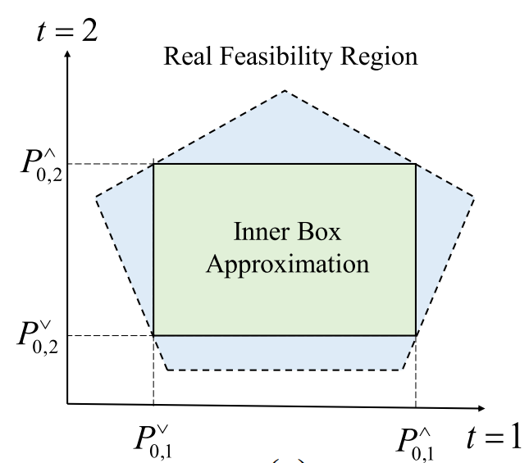
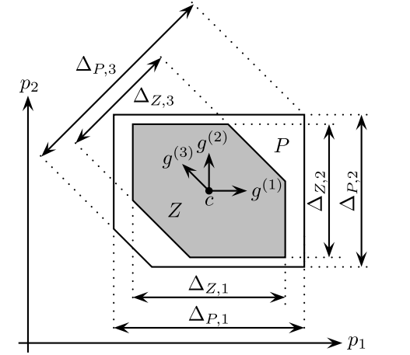
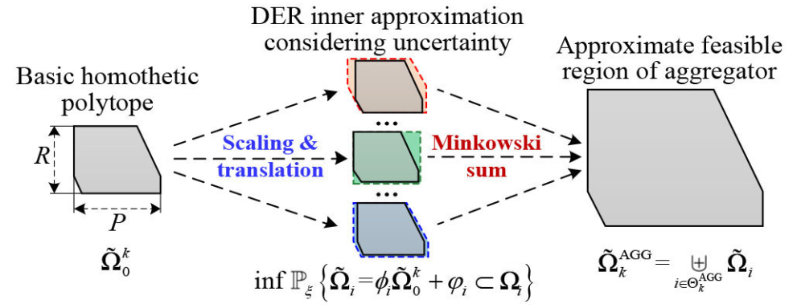

Background
Analytical approximation of aggregate FR
tied with the form of individual FRs, such as box, ellipse, zonotope
rely on assumptions on the operation of individual DERs
cannot be adaptively applied in VPP bidding
Box form of FRs
(Chen et al., 2020)
A PE-polytope P and inscribed zonotope Z (gray)(Muller et al., 2019)
Aggregation of approximate FRs
4

Slide 5
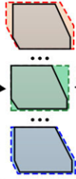
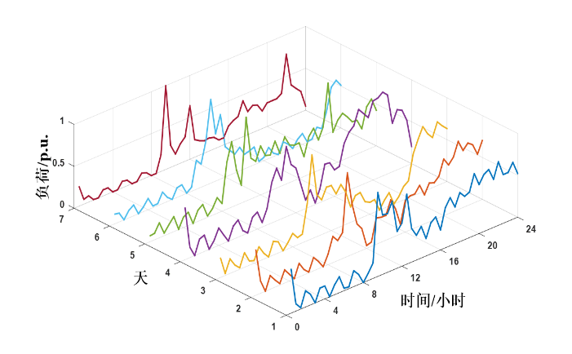
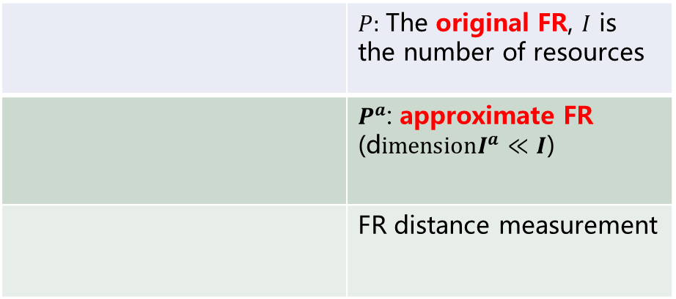
Motivation
Approximate the FR of VPPs in a data-driven manner
abandon the bottom-up computation of analytical methods
use data to determine the parameters of an approximate FR
how to measure the degree of approximation of two FRs?
 | $P:$The original FR, $I$ is the number of resources
 | $P^{a}$: approximate FR (d$imensionI^{a}≪I$)
 | FR distance measurement
load (p.u.)
hour
original FRs
optimal dispatch results
aggregate FR
Data-driven feasible region aggregation
Ruike Lyu, Hongye Guo, Qixin Chen. Approximating Energy-Regulation Feasible Region of Virtual Power Plants: A Data-driven Inverse Optimization Approach. PESGM 2024.
5

Slide 6
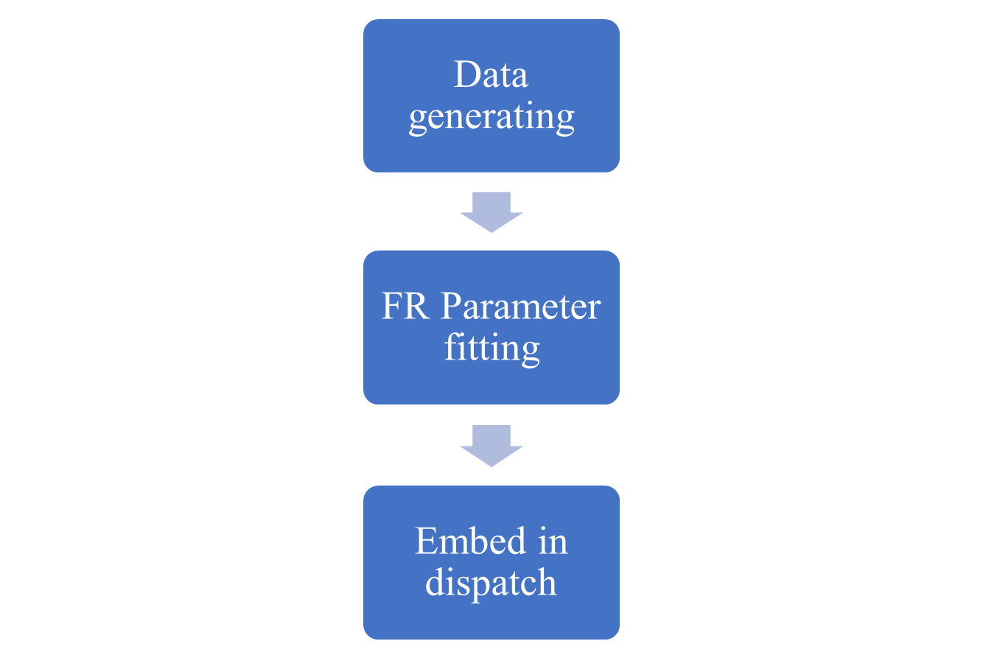
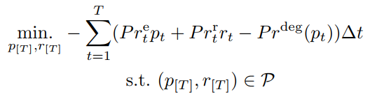
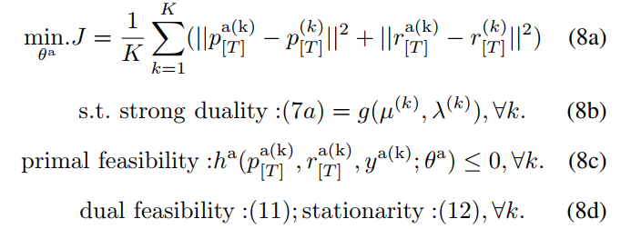
Methodology
Data-driven Inverse Optimization
generate dispatch results using original constraints
regard these data as optimal dispatch results within the approximate FR and fit the parameters of the approximate FR
Idea: if the optimal dispatch results based on the approximate FR under various scenarios are close to the results based on the original FR, then the FR is considered sufficiently approximate.
Loss function
Ruike Lyu, Hongye Guo, Qixin Chen. Approximating Energy-Regulation Feasible Region of Virtual Power Plants: A Data-driven Inverse Optimization Approach. PESGM 2024.
6

Slide 7
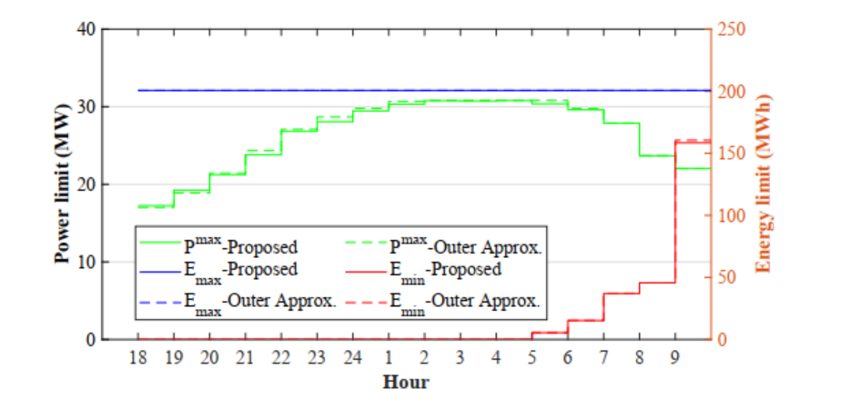
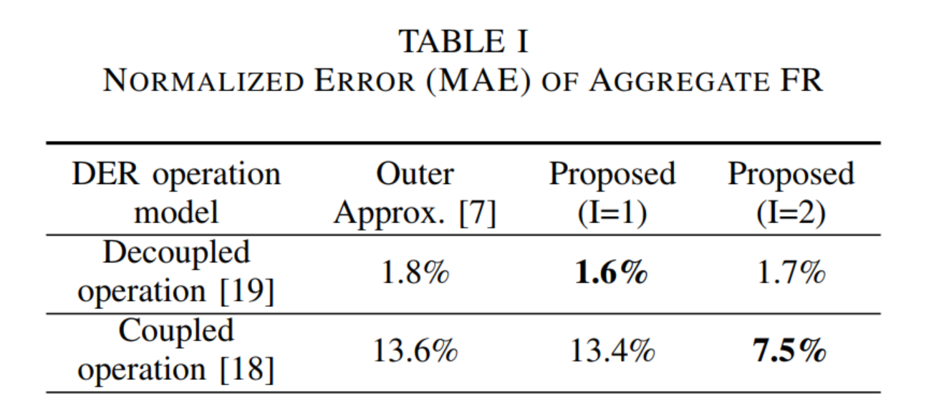
Results and Conclusion
Data-driven method comparable to analytical method
Using prices from PJM to represent dispatching scenarios
Employing FR form of virtual battery to approximate 4000 EVs.
The aggregate FR parameters obtained from the proposed method close to those derived from the analytical approach.
The error in FR aggregation based on the data-driven methods is lower than that of analytical methods in some scenarios.
Ruike Lyu, Hongye Guo, Qixin Chen. Approximating Energy-Regulation Feasible Region of Virtual Power Plants: A Data-driven Inverse Optimization Approach. PESGM 2024.
7

